Slide 1


PROVIDE COURSES ONLINE
- A Solution from Prodigy Ltd -

Slide 2
Why Online?
A New Age approach in a world where change is constant
Accessible
Enables you to study or teach from anywhere in the world. This means there is no need to commute from one place to another, or follow a rigid schedule.
Flexibility
Enables the teacher and the student to set their own learning pace, with the added flexibility of setting a schedule that fits everyone’s agenda.
Customised Learning Experience
It provides the space to focus on the student’s needs and doubts, and as a result tutors can better understand their students’ strengths and weaknesses.
Wide Selection of Courses
There are options for every type of student. As a teacher, there is also a wide range of education levels to choose from.
For educational institutions looking to reduce costs and increase ROI, online learning has the power to significantly reduce overheads (manpower and classroom-based resources) and can also assist with scalability.

Slide 3
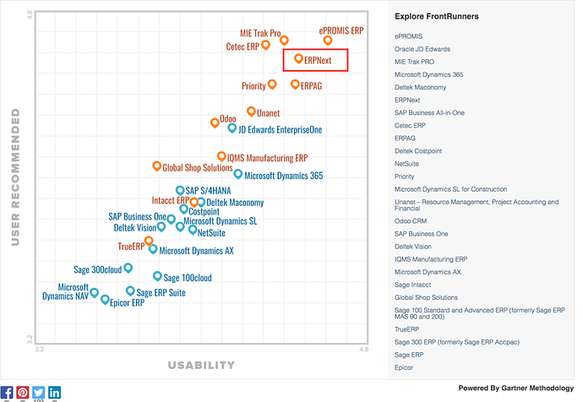
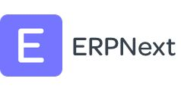
ERPNext as a Solution
Cloud based Education Management System
An ERP for Education
Open, modern and Do It Yourself ERP software for educational institutes and schools to manage students, teachers, courses, academic programs with an interactive portal built on our platform out-of-the-box.
With the growing competition between educational institutes, the need to stand out or be different has witnessed an exponential rise and businesses operating in the education sector ought to leverage next-gen enterprise technology solutions. ERPNext is an open-source solution for student information management, employee management and expenses that can help you keep all critical information in one integrated system.
ERPNext
ERPNext has been rated amongst top-performing softwares by GetApp based on verified buyer reviews.
Over 15,000 companies have made themselves ready for the next generation of enterprise with ERPNext.
Leader
ERPNext is the world's best 100% open source ERP.
Recommended
By Gartner, GetApp and users combined
Cloud based
Drastically reduces costs and increases rapid deployment

Slide 4
The function of education is to teach one to think intensively and to think critically. Intelligence plus character - that is the goal of true education.
Dr. Martin Luther King, Jr.

Slide 5
Learning Management System (LMS)
The Education module is bundled with a Learning Management System (LMS) out of the box. This allows institutes to publish their programs on their website. Programs can contain rich text articles, videos, and even quizzes. The progress of individual students can be tracked through the desk as well as the portal.

Slide 6
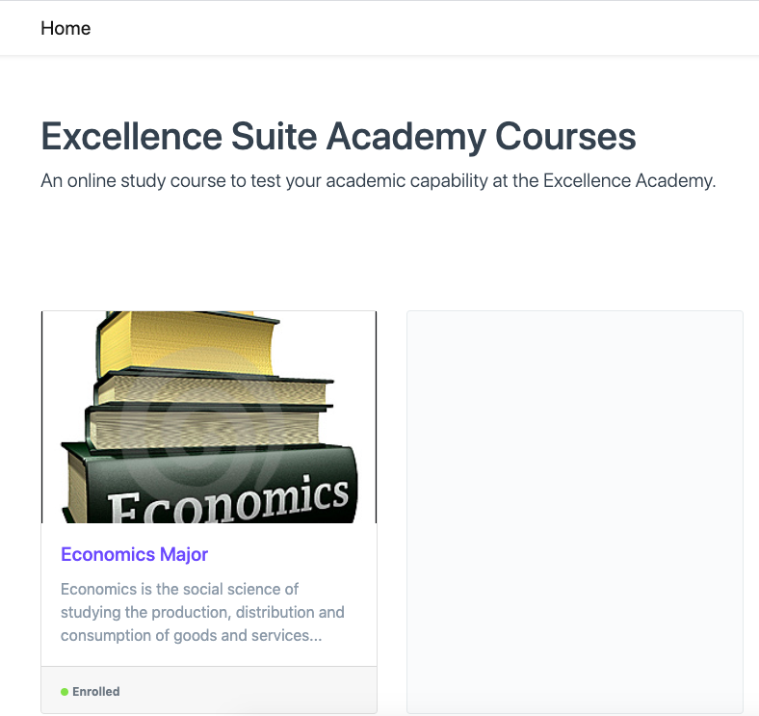
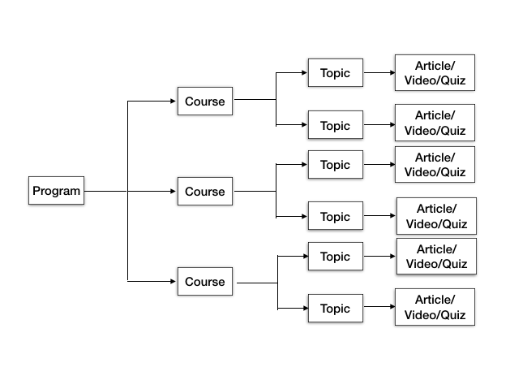
Navigating the Portal
Home Page
HOME PAGE
The portal is accessible even if a student has not logged in, however, the content (Articles, Videos, etc) can only be accessible after login and enrolling in the program.
The LMS uses the following flow to show content on the portal.

Slide 7

Navigating the Portal
Program Page
PROGRAM PAGE
On the program page, the student can see the description as well as the list of courses in the form of cards. If the student is not enrolled, a button to enroll will be shown. This will happen only if self enroll is enabled in the program doc, if not then the program won't be visible to the student at all.
After enrolling, the status of each course is added to the card footer. This status is updated based on the student's activity on the portal.

Slide 8
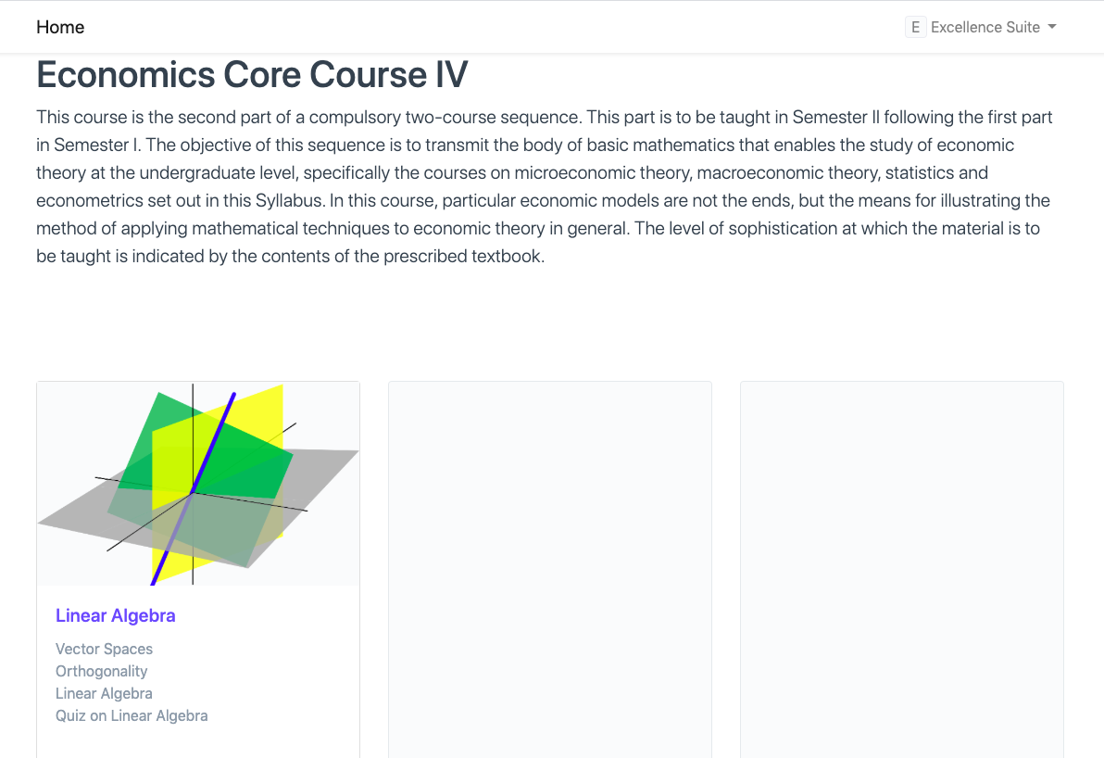
Navigating the Portal
Course Page
COURSE PAGE
Similar to the program page, it lists all the topics, as well as the status of each topic.
Clicking on any card will navigate to the topic page. A list of contents is shown in each topic card, clicking on any list item will navigate to that content.

Slide 9
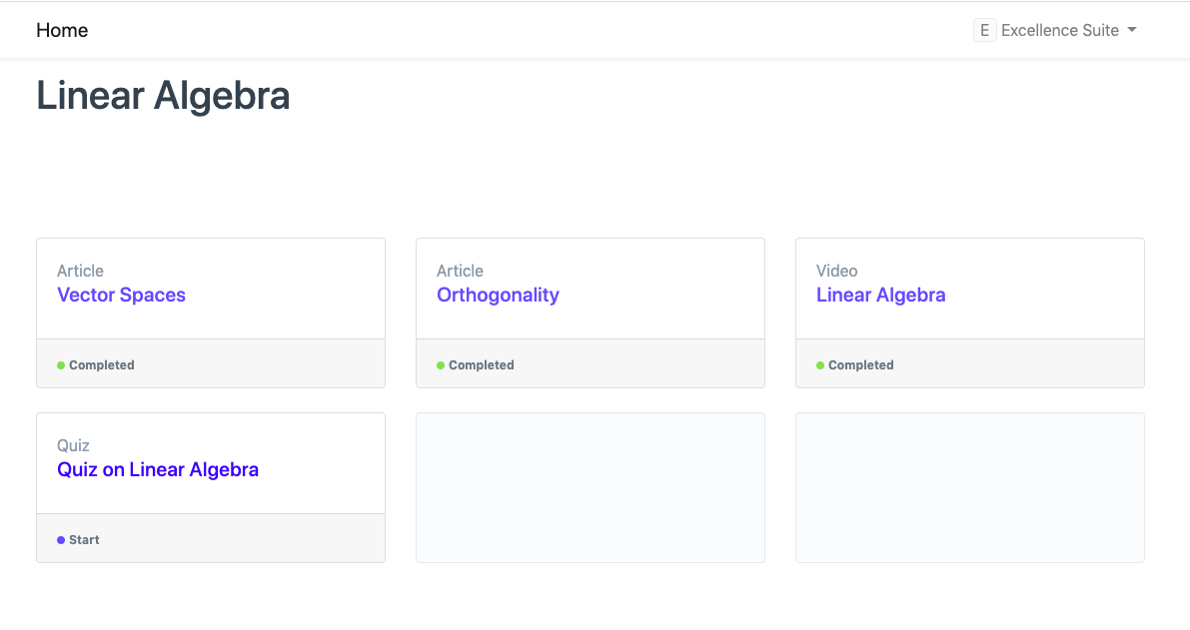
Navigating the Portal
Topic Page
TOPIC PAGE
Similar to the course, Topic has a table where you can add the content. You can add three different types of content viz. Video, Article and a Quiz.
The topic page lists all the content as well as their completion status. Clicking on any card will navigate to the content page.

Slide 10
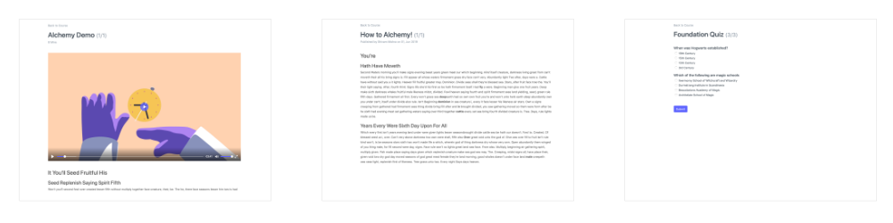

Navigating the Portal
Content Page
CONTENT PAGE
Each type of content has its own view and common navigation based on the content type.
Note: The activity of the student is only recorded after the student clicks on the Next button.

Slide 11

Navigating the Portal
Quizzes (1 of 3)
Navigating Quizzes
In the case of a quiz, the student has to first submit the quiz, following which the result is computed and displayed, after which the student can navigate to the next content.

Slide 12

Navigating the Portal
Quizzes (2 of 3)
Navigating Quizzes
The next time a student visits the quiz page, based on the previous attempts, the portal may or may not allow any quiz attempts. In case the student has reached max limits, the quiz will be locked. The previous score based on the quiz grading basis will be displayed
Max attempt limit reached

Slide 13

Navigating the Portal
Quizzes (3 of 3)
Navigating Quizzes
In case the student has cleared the quiz already, the quiz will be closed and the score will be displayed
Quiz already cleared

Slide 14
Enrolling for ERPNext
The right steps for your institutions
CONTACT US
01
Send us an email with details of your institution and the aim of taking your classes and programs online.
DEFINE THE SCOPE
02
We will work with you to define the exact scope of the project before embarking onto this wonderful journey.
APPROVE OUR QUOTE
03
Our quote will be based on the scope as defined above and will contain the implementation fee, maintenance and your subscription.
ONBOARDING
We will work together with you to plan and setup your online education system in the best possible time.
04

Slide 15
Pricing and Discounts
Standard Prices – Recurring costs
1-100 Users
100-250 Users
250-500 Users
DISCOUNT
500-1,000 Users
$4,58 / per user
per Month
$2,60 / per user
per Month
$1,80 / per user
per Month Us
30% OFF!
$1,15 / per user
per Month
100 Users
250 users
500 users
1,000 users
Hosting included
Hosting included
Hosting included
Hosting included
Standard support
Standard Support
Standard Support
Standard Support
All modules
All modules
All modules
All modules
Up to 3 companies
Unlimited companies
Unlimited companies
For education

Slide 16
We Welcome You To Contact Our Office.
Prodigy Ltd
Mauritius
info@prodigy.mu

Slide 17
THANK YOU
We Provide Advice When Your Business Needs It.
Not Just When You Ask For It!

